Slide 1

Campus Assistant Chatbot Project
Innovative Campus Assistant Using AWS Services
Group C: Li Hao 25401580 / Xie Juyun 25438131
April 2026

Slide 2
Content
Part 01.
Introduction
Part 02.
Cost Management
Part 03.
Technical Fulfillment
4

Slide 3
Introduction
3

Slide 4
What the project aims to achieve
Provide a Telegram Chatbot
Offer a functional Telegram chatbot for HKBU TPg students.
1
Support multiple commands
Enable commands like /start, /course, /interest for user queries.
2
Support natural language conversations
Allow the bot to engage in natural and helpful conversations.
3
4

Slide 5
Cost Management
3

Slide 6
Cost Management Measures
1
2
3
4
Use free-trial eligible instance types
Configure scheduled auto-stop
Remove unused resources
Set CloudWatch billing alerts
Strictly utilize instance types that qualify for free trials to minimize expenses.
Set up automated stopping of instances during non-operational hours to save costs.
Regularly delete unused snapshots, instances, and temporary resources to avoid charges.
Implement CloudWatch alerts to receive notifications about potential unexpected costs.
4

Slide 7
Resource Cost Summary
Resource Type | Specification | Free‑Tier Usage | Monthly Cost after Trial (USD)
AWS EC2 | Instance type: t4g.micro; Architecture: arm64; Number of vCPUs: 2; Storage: 8GiB; Platform details: Linux/UNIX | Date range: Past 6 months; Region: Global; Costs in free plan account are covered by credits | On-Demand Linux pricing: 0.0116 /h × ~730h = $8.468
AWS RDS PostgreSQL | Instance type: db.t4g.micro; Engine: PostgreSQL; vCPUs: 2; RAM: 1 GB Storage: 20 GiB; Storage type General: Purpose SSD (gp2) | Date range: Past 6 months; Region: Global; Costs in your free plan account are covered by credits | On-Demand pricing：$0.018 × ~730h = $13.14; Storage: $0.119 / GB/h × 20 GB = $2.38
AWS CloudWatch | Basic monitoring + logs | Free quota | $0.00 (Covered by free plan)
Total | — | — | ~$23.988

Slide 8
Technical Fulfillment
3

Slide 9
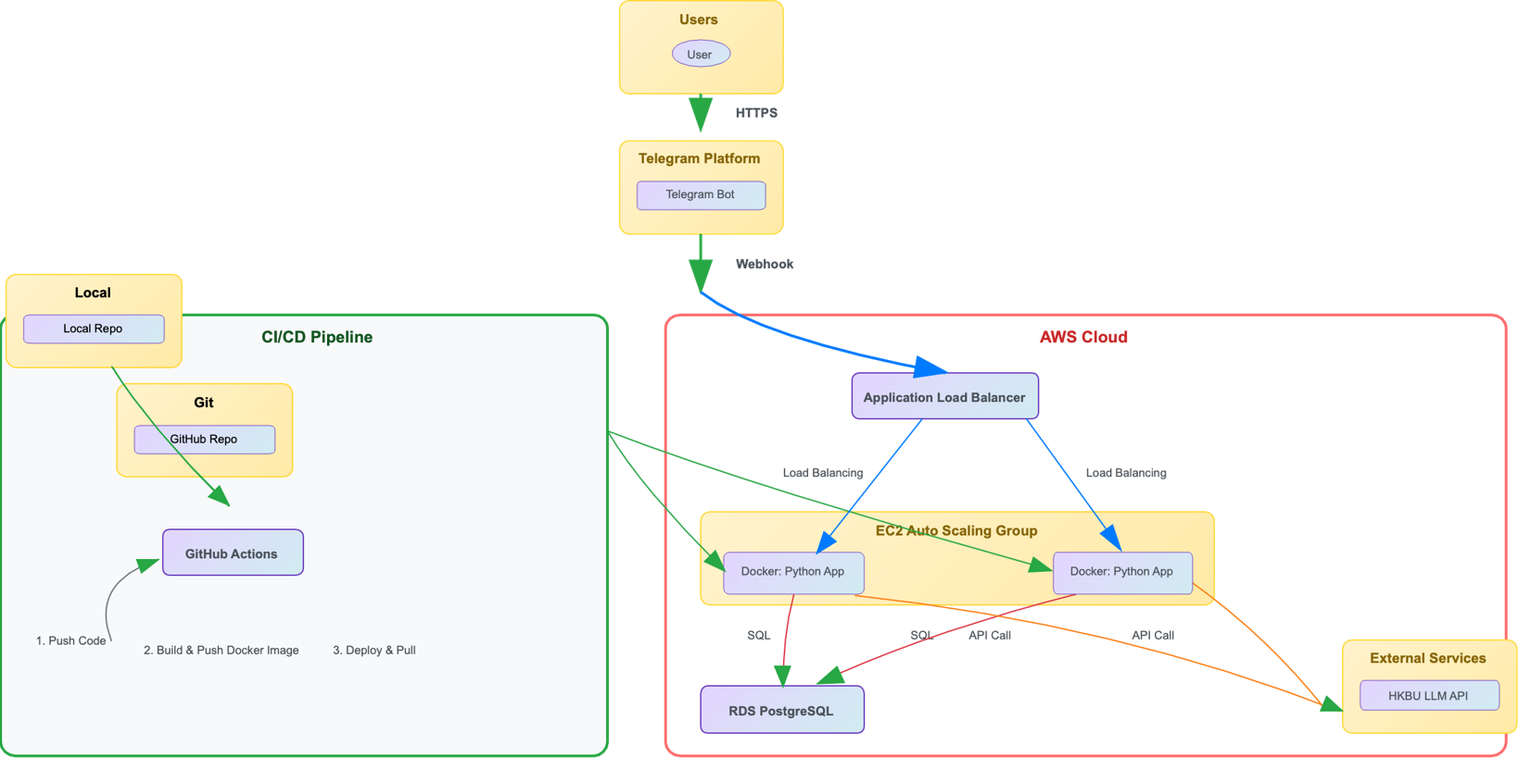
System Architecture Diagram

Slide 10
Must-Have Requirements Compliance
01
02
Telegram Chatbot Functionality
Cloud Database for Data Logging
03
04
Cloud Hosting Application
LLM API Integration
05
06
Git Management
Cloud Monitoring & Cost Control
4

Slide 11

Nice-to-Have Enhancements
1
DevOps Good Practices
Utilize GitHub Actions CI/CD pipeline for automated testing, building, and deploying to the main branch on push, ensuring efficient and reliable software delivery.
2
Load Balancing
Implement AWS Application Load Balancer (ALB) to evenly distribute traffic across multiple EC2 instances, enhancing system scalability and availability.
3
Security Measurements
Enforce security groups to restrict access, apply IAM least privilege, use SSH key login, and ensure no sensitive data is stored in GitHub, maintaining a secure environment.
4

Slide 12
Thank You
Group C: Li Hao 25401580 / Xie Juyun 25438131
April 2026

